Slide 1
Student Performance Factors
By Timothy Kurniawan, Brian Chu, Jaslyne Meriales, and John Pham

Slide 2
Dataset

Slide 3
Student Performance Factors
This dataset provides an overview of various factors affecting student performance in exams. It includes categorical variables as well as continuous variables. These variables provide information on study habits, attendance, parental involvement, and other aspects influencing academic success. There are 6607 points of data and 20 features. In the next slide there are column descriptions.

Slide 4
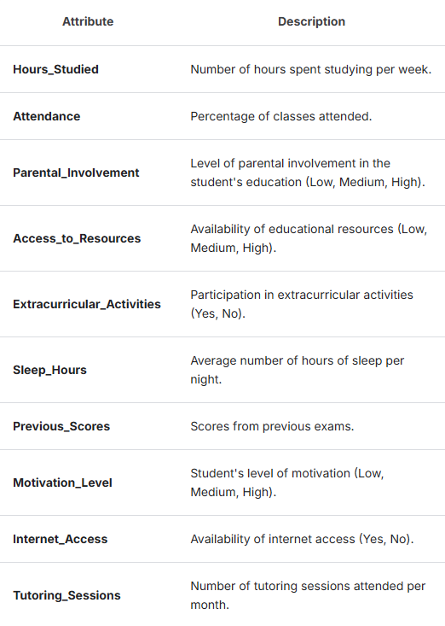
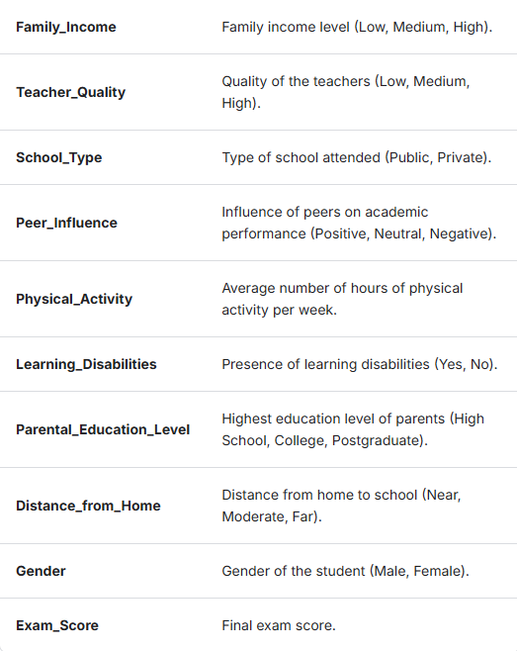

Slide 5
Hypothesis of interest?

Slide 6
Predictions
Hours Studied and Exam Scores:
There may be a positive relationship between the number of hours studied and exam scores. There may be a tendency that students who study for hours perform better on exams.
Attendance and Exam Scores:
Higher attendance may be positively associated with better exam performance. Students with higher attendance rates tend to score better on exams.

Slide 7
Analysis

Slide 8
Analysis of variables

Slide 9
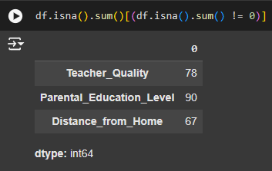
Analysis of variables
After loading our dataset into the variable “df”, we checked for any null values. The results are Teacher_quality, Parental_Education_Level, and Distance_from_Home. Teacher quality being null means the student may not have a teacher (home schooled). Distance from home also means home schooled. And parental education level means the parent may not have any education. We will be removing these rows with null values, leaving us with 6378 data points.

Slide 10
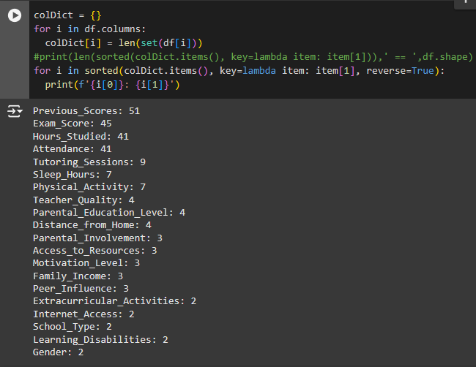
Analysis of variables
After going through the feature descriptions, previous scores, hours studied, attendance, tutoring sessions, sleep hours, and physical activity will be treated continuously while the rest will be treated categorically. In the next slide there will be scatter plots of the continuous variables vs. exam score along with pairplots.

Slide 11
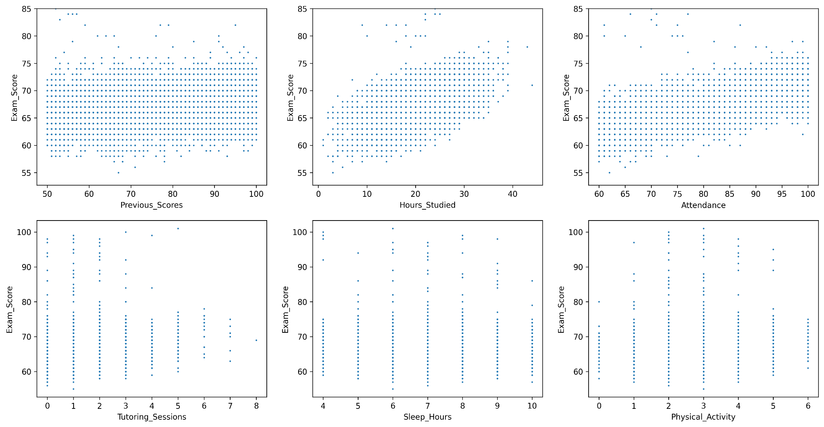

Slide 12
Analysis of variables
There suggests an upward trend between hours studied vs. exam scores and attendance vs. exam scores. Previous scores vs. exam scores trends more flatly but seems to be slightly upward. Tutoring Sessions, sleep hours, and physical activity show less clear trends with points more evenly spread out.

Slide 13
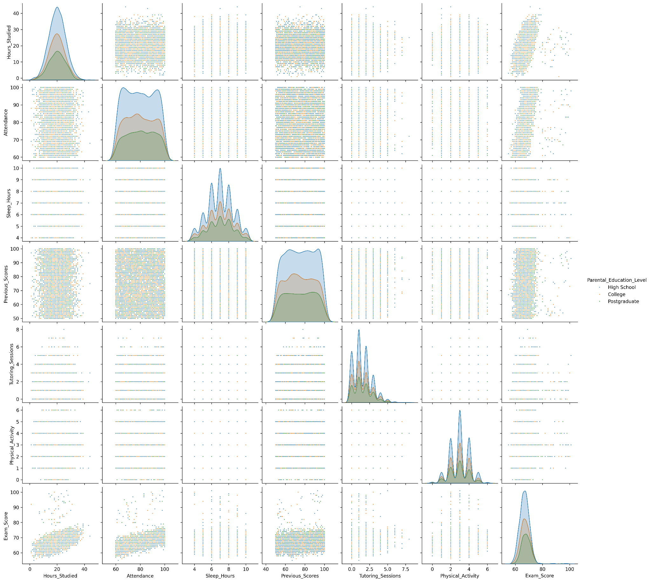
The scattered patterns in the pair plot reveal limited evidence of multicollinearity. In other words, most variables seem to be relatively independent of each other. The histograms on the diagonal show that the distributions of variables are diverse.

Slide 14
Which variables to use?

Slide 15
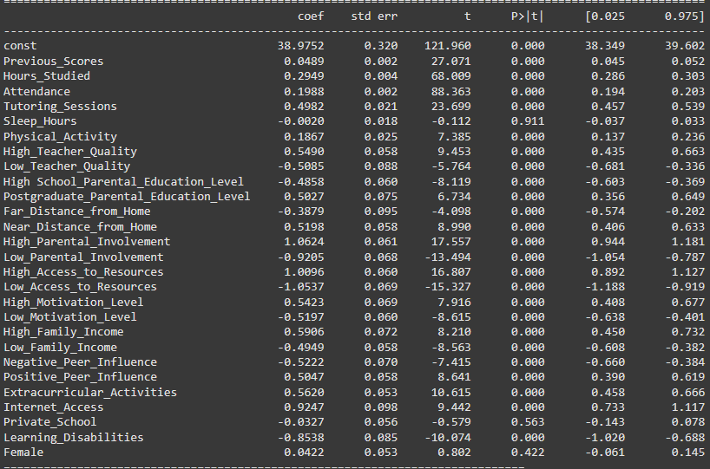
Which variables to use?
Based on our least squares regression results, the only insignificant variables are sleep hours, private school, and female. This is concluded by using a 95% confidence interval. If 0 is included in the 95% confidence interval, then it means we cannot be confident that the variable has a non-zero effect on exam scores. We will omit these variables and continue to train and test without them.

Slide 16
Model training and results

Slide 17
Model Training and results
We trained 5 different model classes and evaluated the results
Linear Regression
Lasso
Random Forest Regressor
KNN
Gradient Boosting
Works by building a tree and then iteratively adding new ones,
instead of using them all at once like a random forest does

Slide 18
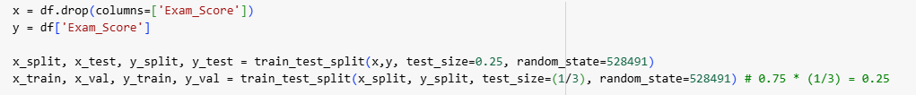
Train Test Split
50% Training data
25% Validation
25% Test
We split the data to include a validation set so that we can use Gridsearch to finetune our hyperparameters and see if that improves our model

Slide 19
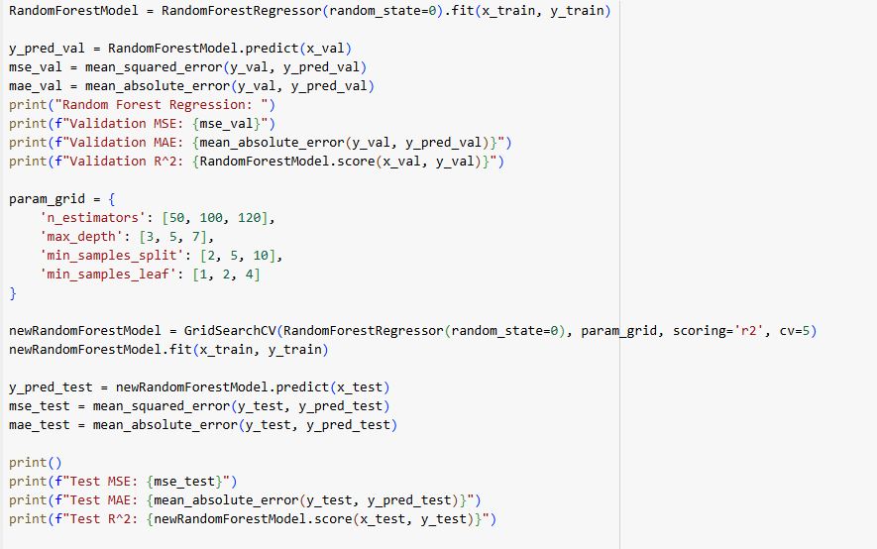
Fitting the models
We used SKlearn to fit the training data to the model classes
We used the validation set to check the metrics such as MSE, MAE, and R^2
We then used GridSearch from SKLearn, passing in hyperparameter options, so that it can find the set of options with the best metrics

Slide 20
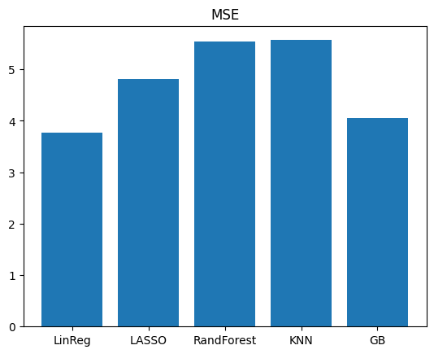
MSE - Lowest
Linear Regression
Gradient Boosting
LASSO
Random Forest
KNN

Slide 21
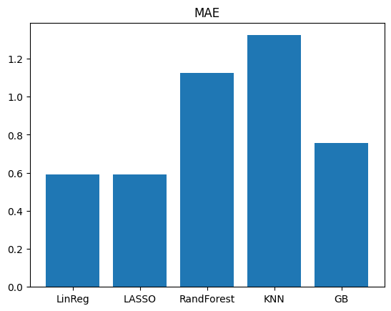
MAE - Lowest
Lasso
Linear Regression
Gradient Boosting
Random Forest
KNN

Slide 22
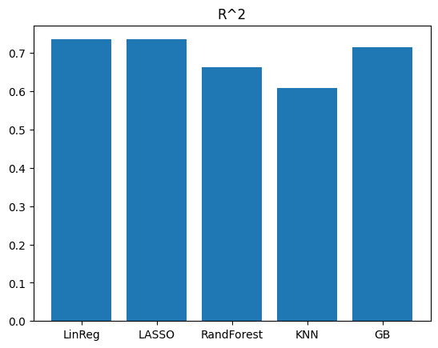
R^2 - Highest
1 Linear Regression
2. Lasso
3. Gradient Boosting
4. Random Forest
5. KNN

Slide 23
Best Model
MAE and R^2 were nearly identical for both Linear Regression and LASSO.
However for Linear regression, the MSE was better by around 1, so we’ll pick that as our best model.
It is likely that Lasso over shrunk and reduced some of the coefficients by too much since there are many predictor variables in our models.
This can be experimented and improved upon in the future by modifying which variables in our dataset that we use.

Slide 24
Evaluating our Hypothesis

Slide 26
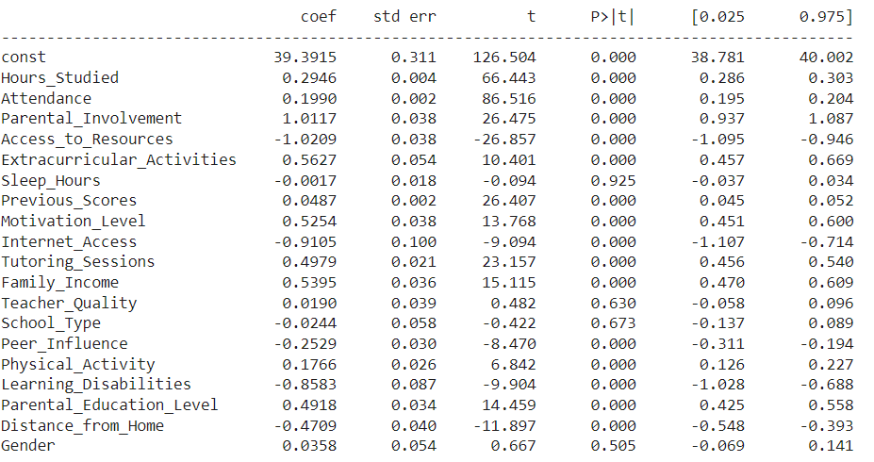

Slide 27
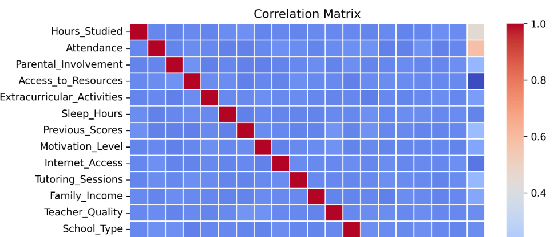
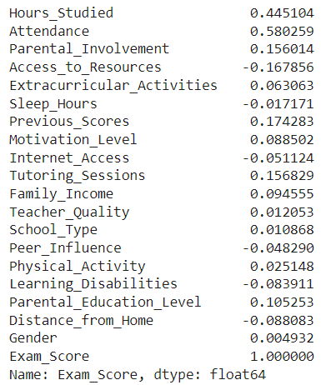
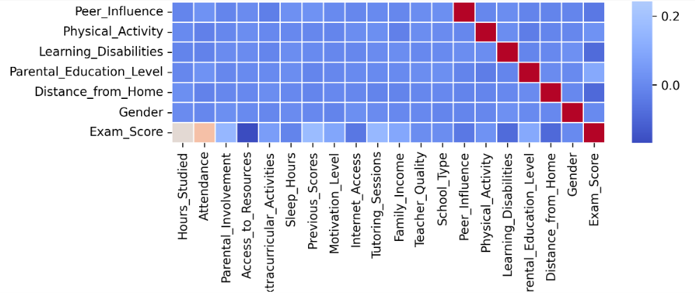

Slide 28
Analysis and Conclusion
Scatterplots:
Hours studied and attendance appear to have high positive correlation with exam scores.
Showcase there is a positive association between higher attendance and exam performance as well as hours studied and exam performance.
Evaluating p-values:
Since p < 0.05 for both hours studied and attendance, this proves that they are statistically significant. They even have a positive regression coefficient, further validating the hypothesis that more hours studied are associated with higher exam scores and better attendance leads to improved exam scores.
Correlation Matrix:
Hours studied and attendance appear to have the strongest correlation with exam scores.
Hence, both hypotheses hold.

